Slide 1
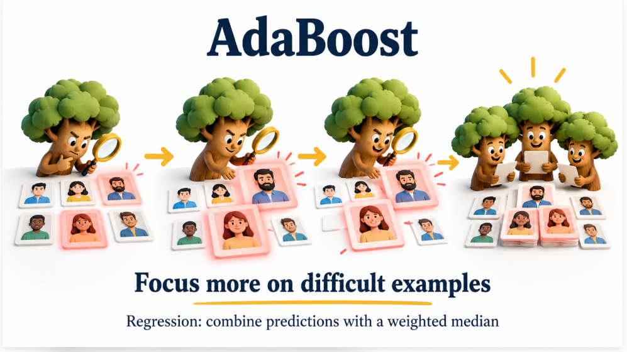
Boosting Algorithm – AdaBoost_Regression
Presented by Rousan

Slide 2

Delivering with confidence
AdaBoost Regression
AdaBoost Regression is a machine learning technique that combines multiple simple models to create one highly accurate predictive model for continuous numerical values

Slide 3
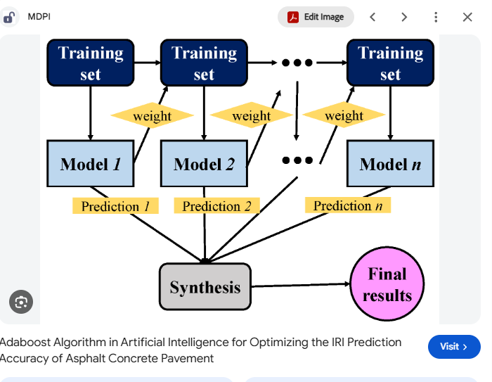

Slide 4
AdaBoost Regressor — Key Parameters and Their Purpose
Parameter | Purpose
estimator | Specifies the base learner. Shallow decision trees help limit model complexity.
n_estimators | Sets the maximum number of boosting rounds. The actual number can be lower.
learning_rate | Controls each learner’s contribution and the observation-weight updates.
loss | Specifies how regression errors are transformed: 'linear', 'square', or 'exponential'.
random_state | Makes randomized sampling reproducible when a fixed value is used.

Slide 5
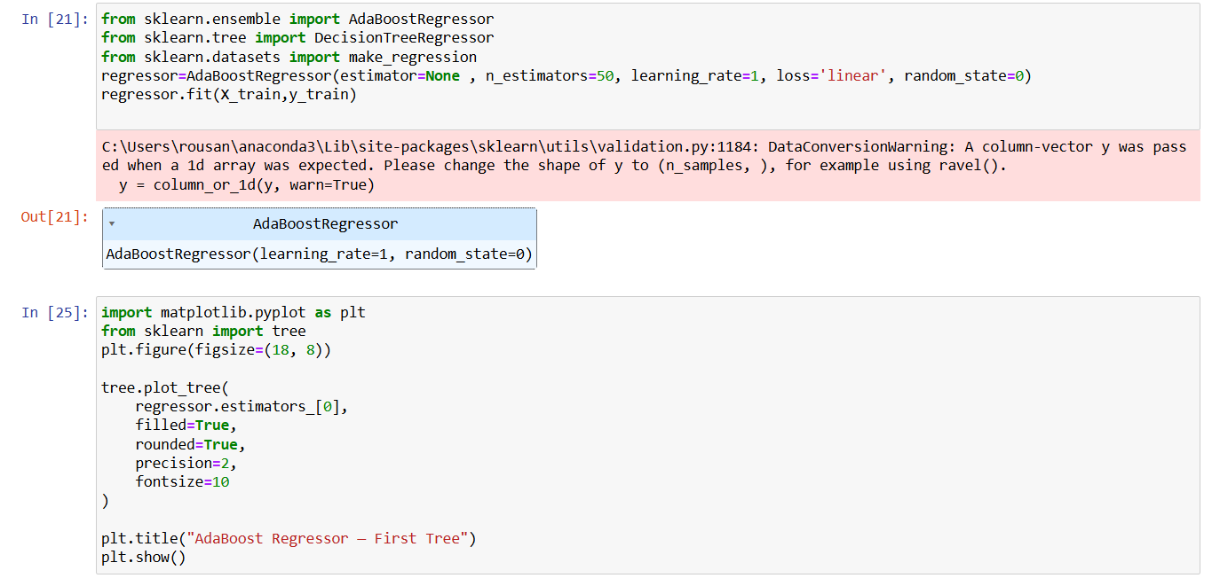
Python Code

Slide 6
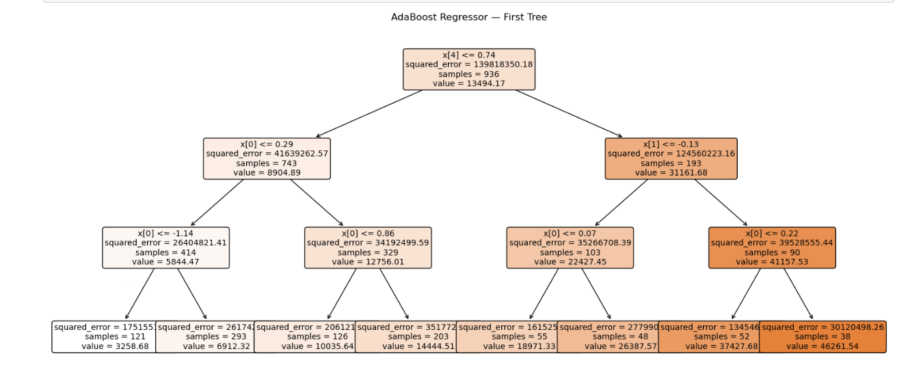
AdaBoost Regressor — First Tree (Example)

Slide 7
How AdaBoost Regression Works
Sequential Training: It builds models one after another. The first model makes a prediction on the dataset.
Weight Adjustment: It calculates the errors (residuals) for each data point. It then increases the weight of the data points with the largest errors
Focusing on Hard Cases: The next model in the sequence is trained on the same data, but it pays extra attention to the heavily weighted, harder-to-predict data points
Aggregation: It combines the outputs of all the weak models—usually shallow decision trees—using a weighted median or average to produce the final continuous prediction

Slide 8
Key Characteristics
Base Estimator: It typically uses a small DecisionTreeRegressor (often with a maximum depth of 3) as its default base model.
Adaptability: The algorithm adapts by changing data point weights dynamically based on previous prediction errors.
Sensitivity: It can be sensitive to noisy data and extreme outliers, because it forces subsequent models to relentlessly chase hard-to-fit points

